Slide 1
Minority Language Project: EkeGusii Language
Peter Nyansera Otieno, Ph.D

Slide 2
INTRODUCTION
EkeGusii language is classified as E42 as in Guthrie (1971). The AbaGusii or the Gusii people are geographically located on the South-West of Kenya. They occupy a fertile hilly country that is very productive agriculturally.
Presently the Gusii occupy two counties, Kisii and Nyamira. This can be seen on the map below.

Slide 3
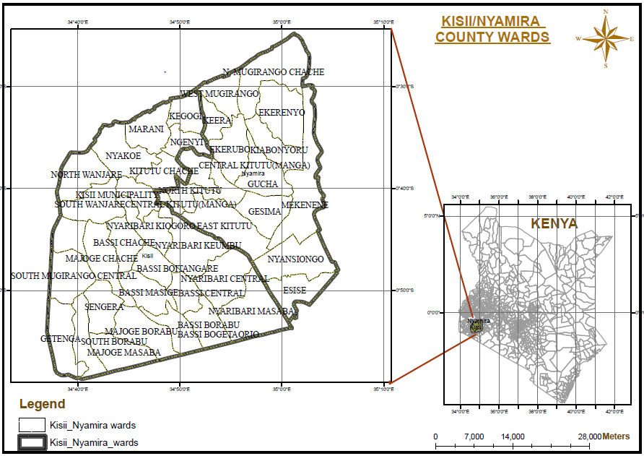

Slide 4
INTRODUCTION Cont’d
Cuppy, (1941) comically but aptly captures the situation that many languages face, including EkeGusii: “Most of us feel that we could never be extinct. The Dodo felt that way too.”
EkeGusii language is the best representation of the Gusii culture and if lost, all culture system goes with it.
EkeGusii could only be a generation away from extinction as it is being edged out of daily use due to rapid and radical linguistic changes in society borne out of modernism.

Slide 5
EkeGusii Endangerment
The language is rapidly staring at its own death if interventions are not put into action. This is seen in three important aspects:
1) dwindling intergenerational transmission – children are no longer learning their mother tongue in the traditional way where the language passes down from one generation to another.
2) decreasing number of speakers.
3) decrease in domains of use. Modern trends have necessitated that the language is relegated to the background, used only by older people.

Slide 6
EkeGusii Endangerment
EkeGusii language faces stiff competition from other languages in the region
English and Kiswahili are used exclusively in school, market, and workplace.
Other dominant local languages like Luo and Kikuyu are taking root as evidenced by many loan words (Read Anyona, 2017).
Intermarriage with dominant communities has made the state to be more precarious

Slide 7
Domains of language use
Trade
Education
Religion
Mass media
Business
Farming
Sports and pass time activities
Cultural rituals

Slide 8
Domains Cont’d
The language situation has changed a lot in recent times and the use of EkeGusii is now relegated to home use and only by older people.
Domains like trade, education, business, sports, farming, and religion have all been taken over by Kiswahili and English.
We rarely have activities that require expression in EkeGusii language like traditional circumcision and weddings due to Christian religion domination of all aspects of social life.

Slide 9
Domains Cont’d
Pass-time activities like sports and entertainment like this one in the following picture of two men playing Ochwa on a sculpted wooden board which have only indigenous terms are dying out.

Slide 10
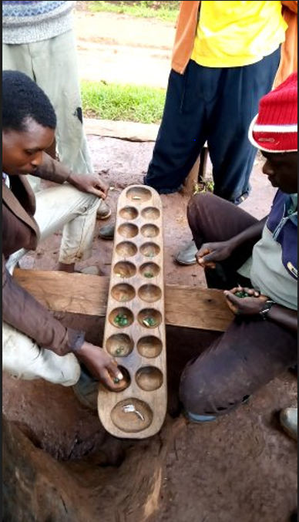

Slide 11
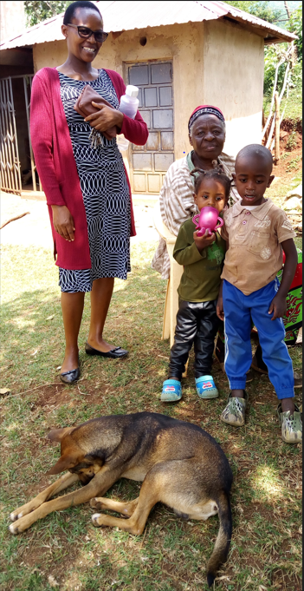
Children growing with grandparents in rural setting is getting rare

Slide 12
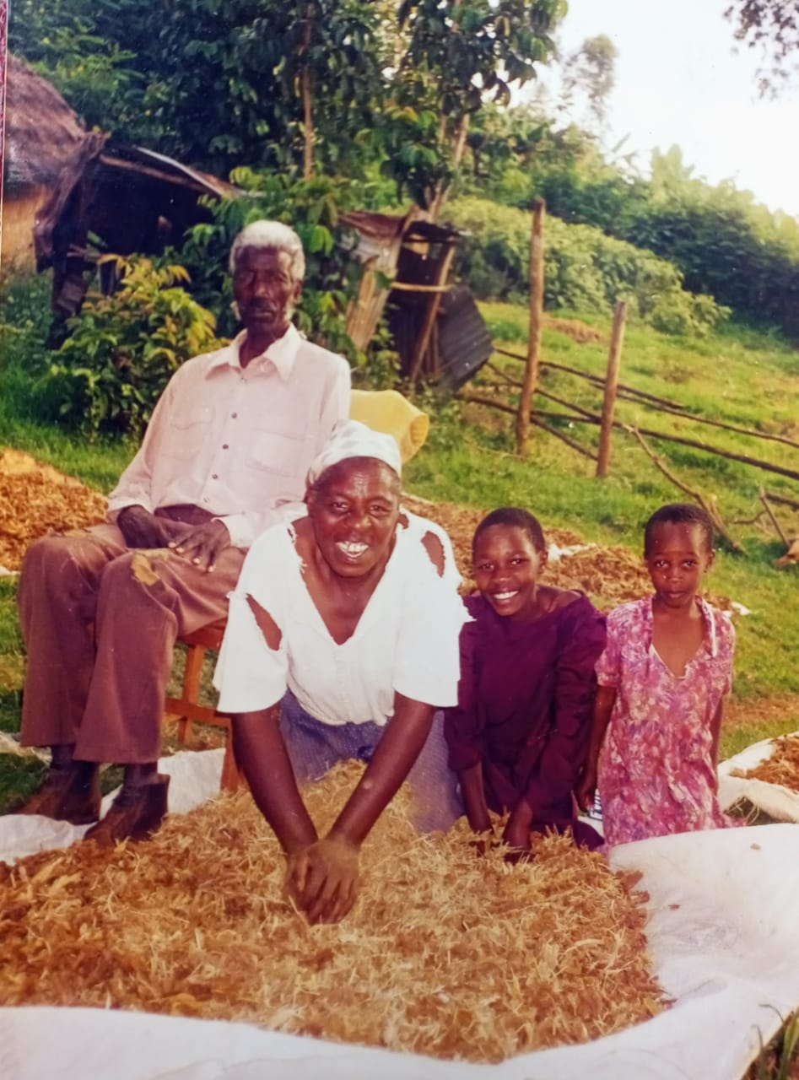
Vocabulary in various home chores for girls like these threshing finger millet

Slide 13
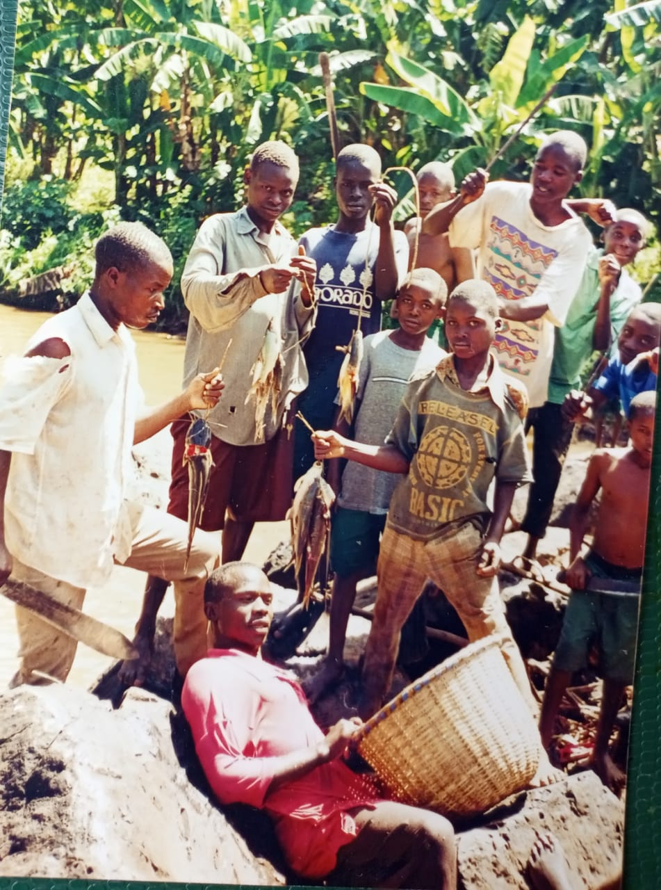
Circumcision initiates (boys) shown how to fish in River Gucha

Slide 14
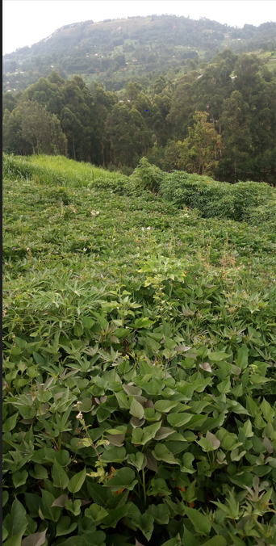
Local food: Sweet potatoes, cassava and pumpkin leaves…are no longer grown

Slide 15
Loss of flora and culturally significant shrines. On the background of the above picture is the legendary Sameta hill (one of the two most sacred hills of the Gusii), a place where rainmakers used to sacrifice during dry periods to beseech ancestors to send rain. All vocabulary related to these practices are lost as none practices such anymore.

Slide 16
It is more than cultural activities loss: it is language loss
European foods, education and religion have made Gusii cultural life and economy almost obsolete
This culture is dying with the lexicon items attached to it.
Such losses include traditional neurosurgery as you can watch on You Tube: https://oddafrica.com – A Kisii Traditional Healer Performing Brain Surgery (!!!Graphic content not appropriate to some viewers)

Slide 17
EkeGusii Sound system
The sound system of Ekegusii can be analyzed from the segmental and suprasegmental perspectives.
A segmental description - consonants, vowels (monophthongs, diphthongs, and triphthongs)
Suprasegmentals - tone, and syllable structure.

Slide 18
EkeGusii sound system: vowels
EkeGusii has seven vowel phonemes with a length distinction (for a deeper acoustic discussion on EkeGusii vowels see Otieno & Mecha, 2019). That is, for every vowel phoneme, there is a corresponding long vowel counterpart. These vowels are /i e ɛ a ɔ o u /. The vowels are evenly distributed between the front and back distinction, that is, three front vowels /i e ɛ/, three back vowels /ɔ o u/, and one low, central vowel /a/.
Their distribution on the vowel chart can be seen below

Slide 19
EkeGusii Vowel chart (Source Otieno, 2020)

Slide 20
EkeGusii Vowel chart (Source Otieno, 2020)

Slide 21
Diphthongs
EkeGusii diphthongs occur at the beginning, center, or end of a word. These sequences of vowels are very productive in EkeGusii as many words have these diphthongs as seen in the examples below.
Diphthong Standard orthography Transcription Gloss
[ae] baete /ꞵaete/ (they) pass
[aɛ] bae /ꞵaɛ/ (they) give
[ai] kai /kai/ where
[ao] kwao /kwao/ yours (land)
[aɔ] maoto /maɔtɔ/ name of a person

Slide 22
Diphthongs
Diphthong orthography Transcription Gloss
[au] mauti /mauti/ name of a person
[ea] eanga /eaŋa/ cloth
[ei] egeitano /eɣeitanɔ/ strife/conflict
[eo] ekeonga /ekeoŋa/ fish trap/net
[eu] eura /euɾa/ undigested stomach contents
[ɛɔ] eome /ɛɔmɛ/ smear oneself
[ia] tiana /tiana/ swear
[ie] tiema /tiena/ leap playfully

Slide 23
Diphthongs
Diphthong orthography Transcription Gloss
[ae] baete /ꞵaete/ (they) pass
[iɛ] tiera /tiɛɾa/ eat huge food quickly
[io] sioka /sioka/ appear suddenly
[iɔ] eriogo /eriɔɣɔ/ medicine
[iu] riuro /ɾiuɾo/ foam
[oa] goaka /ɣoaka/ to beat
[ɔa] soa /sᴐa/ enter
[oe] moeti /moeti/ make him/her pass

Slide 24
Diphthongs
Diphthong orthography Transcription Gloss
[ɔɛ] toe /tɔɛ/ give us
[oi] oigo /oiɣo/ name of a person
[ɔi] boigo /ꞵɔiɣɔ/ also
[ou] bouti /ꞵouti/ name of a place
[ua] buati /ꞵuati/ follow
[ue] tuera /tueɾa/ spit on
[uɛ] suebeka /suɛꞵɛka/ become less swollen
[uo] tuoma /tuoma/ push
[uɔ] etuoni /etuɔni/ cock/roaster

Slide 25
Triphthongs
Ekegusii has a combination of vowels gliding from one vowel to another and then to a third vowel produced rapidly without interruption. A few vowels appear as triphthongs, unlike the highly productive diphthongs.

Slide 26
Triphthongs
Triphthong orthography Transcription Gloss
[aei] baeire /ꞵaeire/they have given
[iai] giaito /ɣiaito/ ours
[iao] ekiao /ekiao/ yours
It is worth noting that some triphthongs could result from a combination of a prefixed vowel combining with those of a root word. Care was taken, for the examples above, to exclude such words as they will not be a true reflection.

Slide 27
EkeGusii consonant system
The earliest work on the EkeGusii sound system by Whiteley (1965:3) identifies EkeGusii consonants as follows: [β γ m n ʧ ŋ ɲ ɾ s t j ɰ k p], a total of fourteen. The IPA chart of Ekegusii would then look as seen below

Slide 28
Consonants
 | Labials | Labiodentals | Alveolars | Palatals | velars
Plosives | p |  | t |  | k
Nasals | m |  | n | ɲ | ŋ
Flap |  |  | ɾ
Fricatives | β |  | s |  | γ
Approximants |  |  |  | j | ɰ
Affricate |  |  | ʧ

Slide 29
EkeGusii consonant examples
Orthography IPA symbol Example Transcription Gloss
B,b β baba /βaβa/ mother
G,g γ gaki / γaki/ please
K,k k kaana /ka:na/ deny
M,m m amate /amate/ saliva
N,n n enogo /enoγo/ fool
P,p p pi /pi/ completely
R,r ɾ riina / ɾi:na/ climb
S,s s sata /sata/ decorate
T,t t tota /tota/ become soft
Y,y j yee /jɛ:/ give it
W,w w rigwari /ɾiγwaɾi/ zebra
NY,ny ɲ enyanya /eɲaɲa/ tomato
NG,ng ŋ engiti /eŋgiti/ beast

Slide 30
EkeGusii Syllable
The basic syllable in Ekegusii is made up of a vowel segment preceded by zero or more consonantal segments. Like all languages, the nucleus in Ekegusii is a vowel – the peak of a syllable. This can be represented as:

Slide 31
Ekegusii Syllable

Slide 32
Ekegusii Syllable

Slide 33
EkeGusii Syllable
From the above schema, notice that the nucleus is an obligatory element in every EkeGusii syllable and it marks the end of the syllable. It contains a short vowel, a long vowel, or a combination of vowels. The nucleus must also contain a minimum of one Mora (μ) and at most two moras.
EkeGusii rhyme does not branch. Codas are not possible in the language (Nash, 2011). EkeGusii does not have a coda after the nucleus since every syllable ends in a vowel. For the two constituents, the nucleus is obligatory while the onset is optional. When in other languages like English the nucleus must not be always a vowel (Davenport and Hannahs 2005), in EkeGusii the nucleus must be a vowel.

Slide 34
EkeGusii syllable
Onsets of EkeGusii syllables have several possible permutations as seen in Nash, (2011) which is extended in this work to be three from two according to Nash. They are a single consonant, prenasalized consonant, consonant glide, prenasalized consonant, and glide. Therefore, a maximal Ekegusii syllable can be represented in a tree diagram for the word nchaa /nʧwa:/ ‘come here’ as:

Slide 35
EkeGusii syllable for the word nchwaa ‘come here’

Slide 36
EkeGusii syllable
The only possible onsets in Ekegusii are:
(1) Ø
(2) C
(3) NC
(4) CG
(5) NCG
This is demonstrated in the following table.

Slide 37
EkeGusii syllable
Onset | Rhyme | Word in Ekegusii | Gloss
Ø | V | oɣa | make noise
Ø | VV | o:ɾa | thresh
C | V | sami | grab
C | VV | Se:mi | educate
CG | V | bwata | catch
CG | VV | gwe:na/bwe:na | get well
NC | V | mbaɾɛ | should I count?
NC | VV | mba:ɾɛ | should I operate?
NCG | V | mbwatɛ | I have
NCG | VV | emwa:mu | black/dirty

Slide 38
Tone in EkeGusii
EkeGusii is seen to employ tone to distinguish word meanings or to convey grammatical distinctions. The tone in EkeGusii serves to mark different verb tenses, possession, negation, and nominal categories. In this way, the meanings of the same phonemic segments, in the same arrangement, are distinguished by the pitch patterns as in the following example:

Slide 39
Tone in EkeGusii
Transcription Gloss
/mˋoʹakˋe/ beat him/her
/mˋoˋakˋe/ (Pl-you) paint
/kˋaɾwʹa:/ go away
/kʹaɾwˋa/ have difficulty (doing something)

Slide 40
Tone in EkeGusii
There are three tone patterns in EkeGusii: High (H), Low (L), and Falling. Nash, (2011) points out that falling tone is only found on long vowels, hence not contrastive in the language just like H and L tones. We can therefore assume that the falling tone is a kind of movement from H to L in a concatenation.

Slide 41
Tone in EkeGusii
Tonal variations in EkeGusii are also used to distinguish dialectal identities between speakers of Ekerogoro and Ekemaate dialects.

Slide 42
Summary
EkeGusii language is already endangered as it is being edged out of daily use.
Deliberate effort is the only way to save this once very vibrant language and culture.
This can be done by government policy especially in education by using the language in school, cultural reawakening, and language documentation.

Slide 43
Thank you!

